Slide 1

Binary Subreddit Classification: Environment vs Cryptocurrency
By Jason Leung
General Assembly Data Science Immersive

Slide 2
Problem Statement
-My proof-of-concept goals were 2-fold:
1. On machine learning side, to extract and analyze the full range of posts from two subreddits and perform accurate binary classification between them
2. On technological side, to test web scraping functionality, natural language processing tools and a range of data science models

Slide 3


Posts Extracted - Reddit vs Pushshift API
-Reddit API server side limitation to 1000 posts in any listing, can’t use date query to bypass this since start of 2018
-Pushshift API, has all raw post json data but Pushshift captures post json from reddit several minutes after post is created
-Cons: no comment, up/down vote and later post edits/removal, by users & moderators
Extracted 400k+ posts for Cryptocurrency subreddit from present to 1.5 years ago
Extracted ~200k posts for Environment subreddit from present to 8 years ago

Slide 4
Data Munging and Lemmatizing
-Extracted from each post’s raw json:
- Title
- self text
- post url link
- author
- permalink
Lemmatizing:
Beforehand removed all numbers and punctuation
Extracted words from url: separated by underscore, slash, punctuation
Count Vectorized only words greater than two letters long
Must lemmatize with matching part of speech to get lemma of non-nouns
Minimum word frequency of 15 over whole corpus and in round 2, over 40
(cut word features from 18k to 10k)

Slide 5
Spam Posts - Variations and How to Identify
Advertisements for products
Blatant promotions for an organization / cryptocurrency
Spam text, repetition of words, no intention to share info
Cut out all posts where more than half of post’s words were below cut-off frequency of lemma dictionary (targeting compound nonsense words ex: aautomoderator)
Posts that violate Reddit or Subreddit specific rules of posting
[removed] by reddit moderator
[deleted] by user
Posts with basically only images (as can’t parse image content)
Example Spam lemma: elon musk want use rocket intercity travel earth themerkle elon musk want use rocket city city travel earth

Slide 6
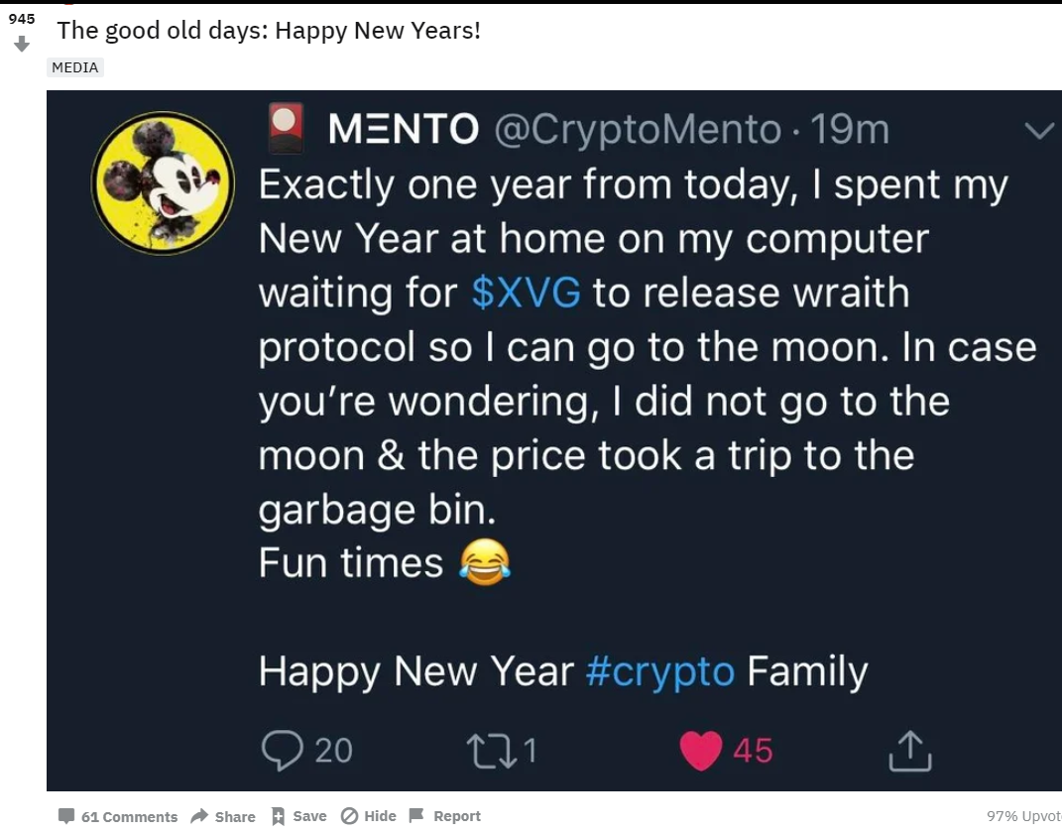
Posts with Images, Spam or No?

Slide 7
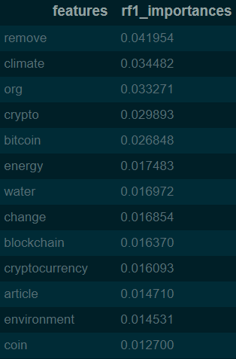
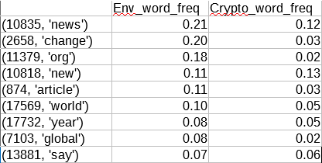
Using Count Vectorize Data, How Can You Classify By These Subreddits?
In Crypto top 10 most frequent words:
1st: 'crypto'
2nd: 'bitcoin'
4th: 'remove'
5th: 'blockchain'
7th: 'exchange'
8th: 'new'
In Environment top 10 most frequent:
1st: 'climate'
2nd: 'news'
3rd: 'change'
4th: 'org'
6th: 'new'
9th: 'water'
10th: ‘oil’

Slide 8
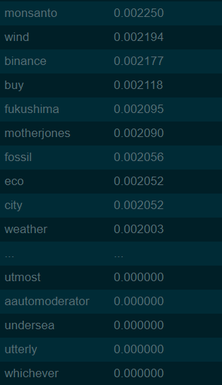
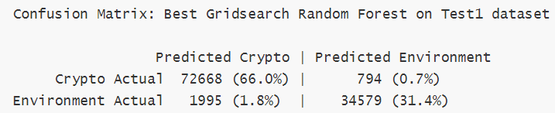
Best Models: Random Forest
-Gridsearched for best Random Forest hyperparameters
After leaving out all <0.02% word features (huge overlap with words with very low predictive coefficients)
Achieved high overall accuracy, given that the classification is usually easy

Slide 9
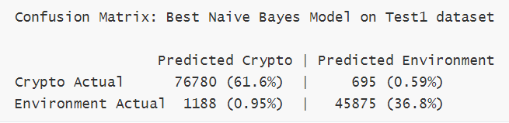
Best Model: Naive Bayes Multinomial
Naive Bayes Multinomial regularly achieved even higher accuracy
With much more forgiving memory limitations
And much faster runtime!
Within this error margin are many perfectly acceptable overlapping subreddit posts:
-Post lemma: cryptoeconomics climate change transparent carbon market
blockchain zengineeringpodcast christophe jospe nori climate change reverse

Slide 10
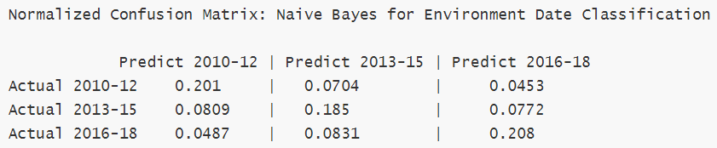
Environment Date Classification
-Wide date range, 1 year gap between each of 3 date classes
-Arbitrary date ranges, but by calendar year to combat seasonality of post content in subreddits like environment
-More success than expected. For each date class, had more accurate than incorrect predictions. In addition, wrong predictions were guessed more frequently in the adjacent date range.

Slide 11
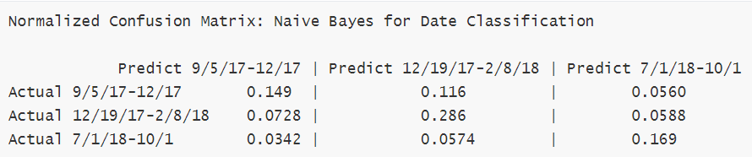
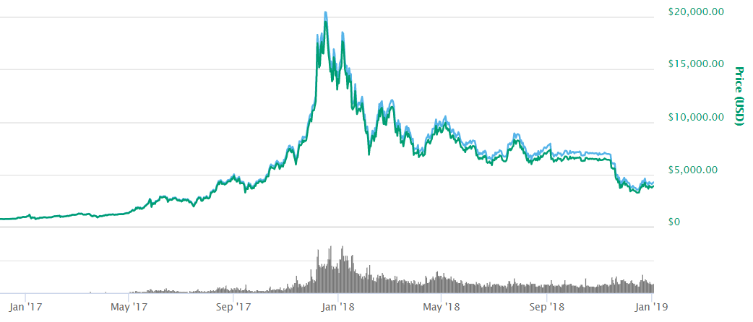
Cryptocurrency Date Classification
-With targeted date ranges aligned with crypto index’s change over time:
- class 1 during sharp value gain
- class 2 during sharp depreciation
- class 3 during neutral value period
-For each date class, had proportionally more accurate than incorrect predictions than environment dataset.
Date class 1
Date class 2
Date class 3

Slide 12
Conclusions and Next Steps
-The project's NLP procedure has a high degree of accuracy for the task of binary classification
of albeit unrelated subreddits.
-Don’t be too ambitious, you’ll run into hardware limitations (at multiple bottlenecks needed
to cut data, compress, access from disk, hdf5 etc.)
Next steps (in order of scope):
-Expand number of subreddits from 2 to 3-10
-Extract majority of true words from human compounded words, ex: themerkle
-Extend date range and even spam classification approach
-Add more complex NLP features, n-grams, feature engineering
-Possible substantial overlap between new subreddits, ones which it is hard for humans to
identify between
-Hopeful to see if these approaches relate to creating W3C’s Semantic Web.

